Slide 1
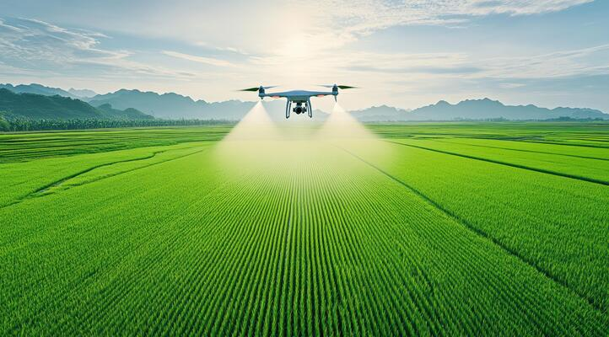

PREDICTION OF UAV SPRAYING DRIFT IN INDOOR UAV LABORATORY, UPM
Presented by: AZMEER BIN AHMAD SHUKRI
Supervisor: TS. DR. ANAS BIN MOHD MUSTAFAH
INTRODUCTION
METHODOLOGY
RESULT
UAV spraying in Agriculture
Importance of predicting spray drift.
UPM laboratory study.
Objective statement
CONCLUSION
Laboratory setup
Data collection
Findings
Meteorological factors that affect the spray drift
Future Work
Implications for agricultural practices

Slide 2
PREDICTION OF UAV SPRAYING DRIFT IN INDOOR UAV LABORATORY, UPM
Presented by: AZMEER BIN AHMAD SHUKRI
Supervisor: TS. DR. ANAS BIN MOHD MUSTAFAH
INTRODUCTION
METHODOLOGY
RESULT
UAV spraying in Agriculture
Importance of predicting spray drift.
UPM laboratory study.
Objective statement
CONCLUSION
Laboratory setup
Data collection
Findings
Meteorological factors that affect the spray drift
Future Work
Implications for agricultural practices

Slide 3
INTRODUCTION
METHODOLOGY
RESULT
UAV spraying in Agriculture
Importance of predicting spray drift.
UPM laboratory study.
Objective statement
CONCLUSION
Laboratory setup
Data collection
Findings
Meteorological factors that affect the spray drift
Future Work
Implications for agricultural practices

Slide 4
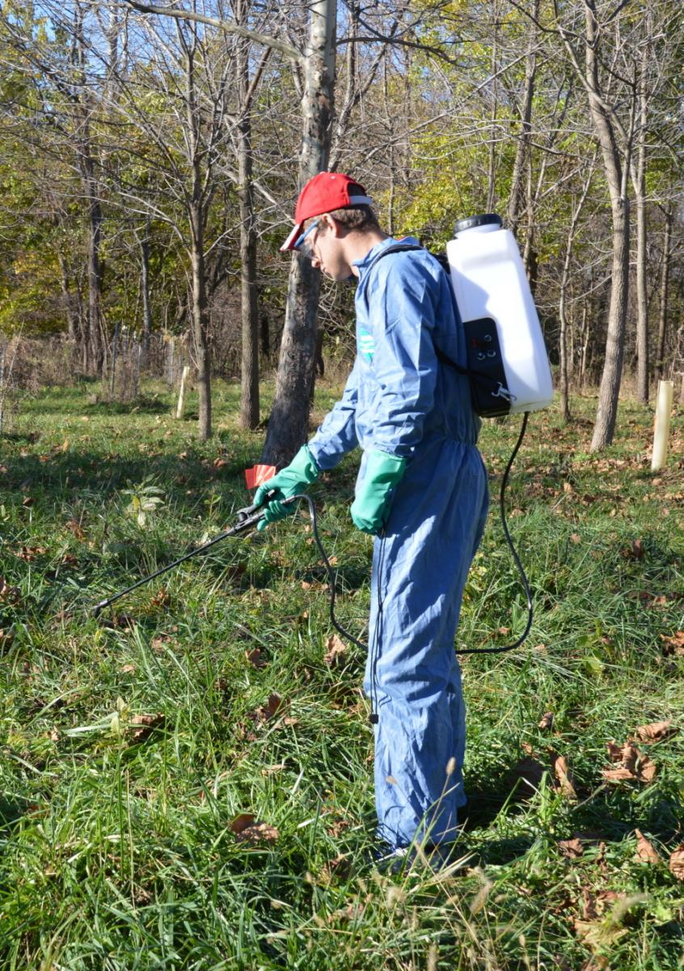
INTRODUCTION
Spraying
In agriculture, spraying is a standard method for applying pest-control, such as insecticides, pesticides, fungicides, and fertilizers, to crops.
It is an important method for controlling insects, diseases, and weeds, and for providing essentials nutrients for plants.
SPRAY DRIFT
UAV
SPRAYING
PROBLEM
OBJECTIVE

Slide 5
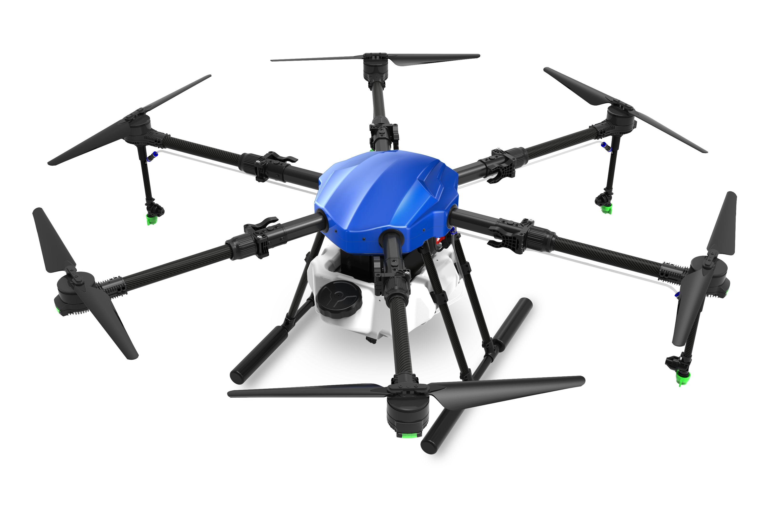
INTRODUCTION
Unmanned Aerial Vehicles (UAV)
Agricultural technology have introduced more automated and mechanized spraying methods, like Unmanned Aerial Vehicles (UAV), also known as drone.
It is defined as an aircraft which is
without a human pilot on board
and functions using autonomous
or remote-controlled technology, which
distinguishes it from typical manned aircraft.
PROBLEM
SPRAY DRIFT
UAV
OBJECTIVE
SPRAYING

Slide 6
INTRODUCTION
OBJECTIVE
Spray drift
It refers to the unintentional movement of sprayed particles beyond the targeted application area, leading to off-target deposition.
It is a common problem in application of UAV in agriculture.
This phenomenon can occur during UAV spraying due to various factors such as environmental conditions and spray equipments.
PROBLEM
SPRAY DRIFT
SPRAYING
UAV

Slide 7
INTRODUCTION
SPRAYING
Problem Statement
Reduced efficiency in pest control or fertilization due to off-target losses.
Environmental contamination, including pollution of water bodies, soil, and non-target crops.
Health risks to nearby humans, animals, and ecosystems exposed to toxic chemicals.
Economic losses for farmers due to wasted agrochemicals and potential damage to neighboring crops.
OBJECTIVE
PROBLEM
UAV
SPRAY DRIFT

Slide 8
INTRODUCTION
OBJECTIVE
Main objective: To enhance chemical spraying deposition of unmanned aerial vehicles (UAV) in agricultural spraying operation
Specific Objective: To observe the effect of artificial wind, flying speed and flying height on distribution spray pattern
Limitation - The experiment was conducted in a controlled environment (indoor UPM laboratory), which may not accurately simulate real-world conditions, such as turbulence and atmospheric conditions.
UAV
SPRAYING
OBJECTIVE
SPRAY DRIFT
PROBLEM

Slide 9
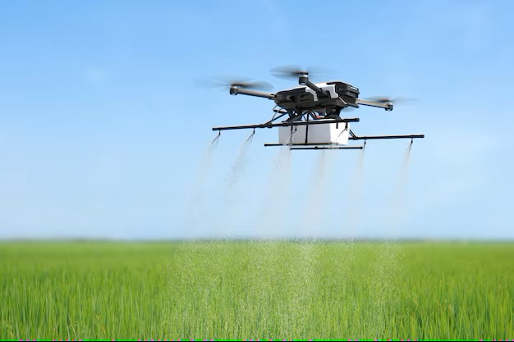
Review of Literature
SPRAYING OPERATION
METEOROLOGICAL FACTOR
TECHNICAL FACTOR OF UAV

Slide 10
Review of Literature
SPRAYING OPERATION
METEOROLOGICAL FACTOR
TECHNICAL FACTOR OF UAV
Current UAV aerial spraying operation lacks precision and are of unsatisfactory levels thus requiring further study (Wang et.al, 2018).
There is a lack of research done in actual field trial which will include dynamic changes in meteorological factors (wind speed and wind direction) (Ahmad, 2020).

Slide 11
Review of Literature
SPRAYING OPERATION
METEOROLOGICAL FACTOR
TECHNICAL FACTOR OF UAV
Wind speeds can significantly elevate the risk of off-target drift, particularly for fine droplets produced by certain nozzle types (Fritz et al, 2014).
The wind directions and speeds varied over time and with heights which will affect aerial spraying differently based on flying elevations and time of day (Amni, 2023).

Slide 12
Review of Literature
SPRAYING OPERATION
METEOROLOGICAL FACTOR
TECHNICAL FACTOR OF UAV
Flying at altitudes between 2 and 3 meters above the canopy significantly reduced drift compared to higher altitudes (Zhou et al, 2018)
Lower flight speeds enhanced droplet deposition accuracy, reducing drift but increasing application time (Wang et al, 2018)

Slide 13
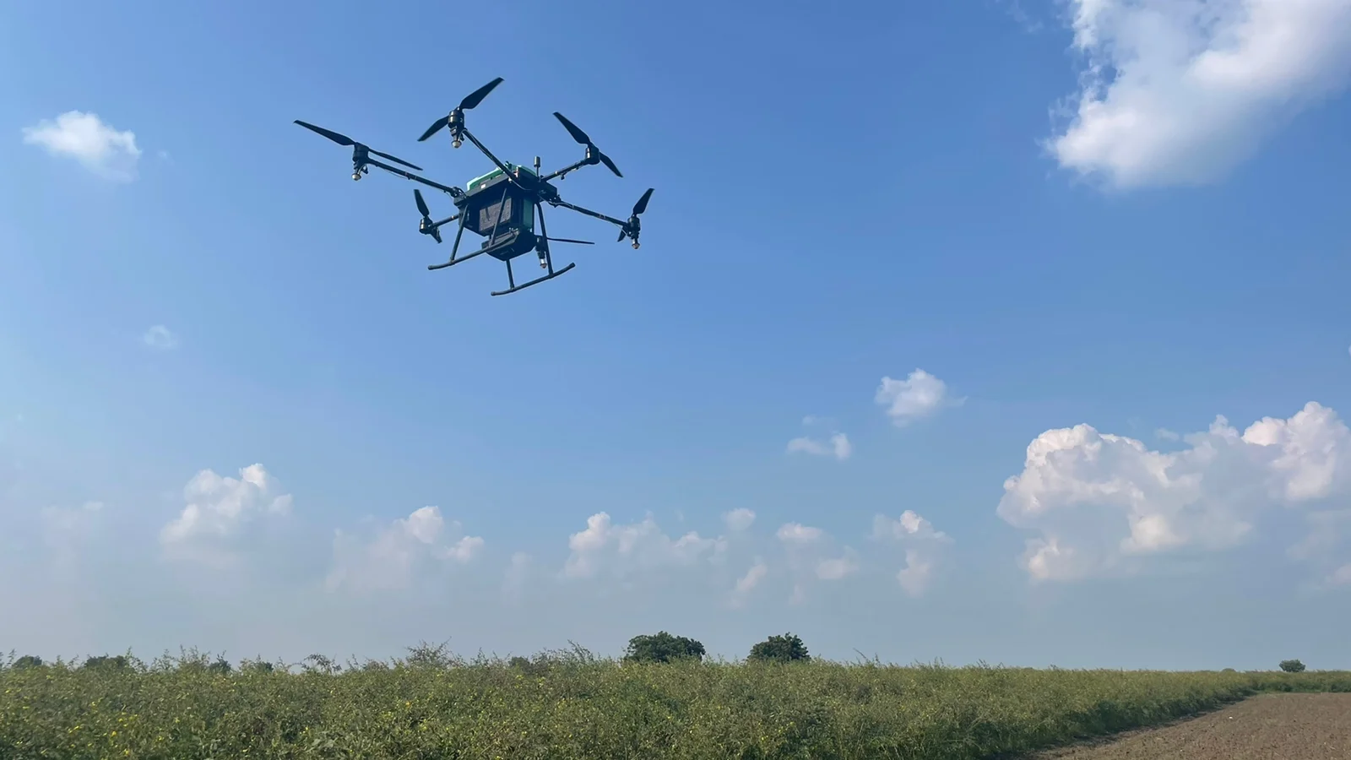
METHODOLOGY

Slide 14
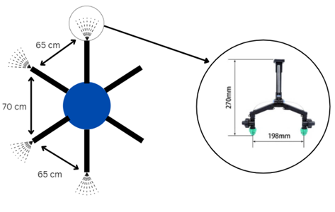
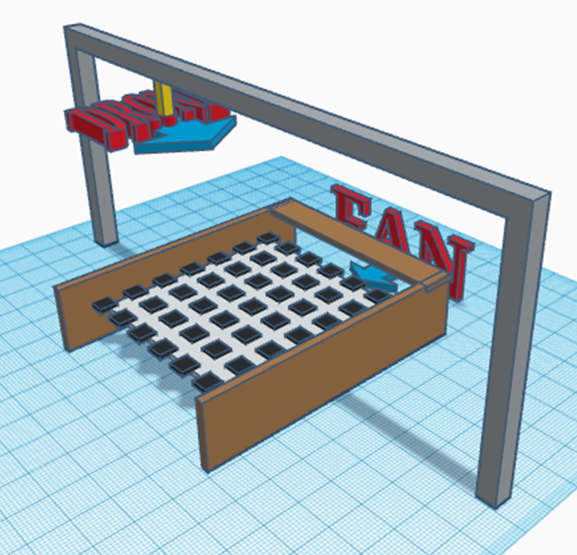
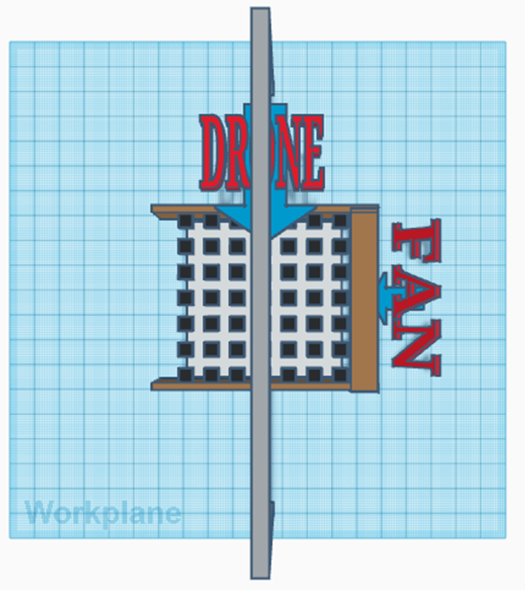
UAV SPECIFICATION
Hexacopter UAV
Advansia A1
Maximum Payload,16 Liter
LABORATORY SETUP
INDOOR UPM LABORATORY
METHODOLOGY
BARRIER CONSTRUCTION
SAMPLING POINT
ARTIFICIAL WIND

Slide 15
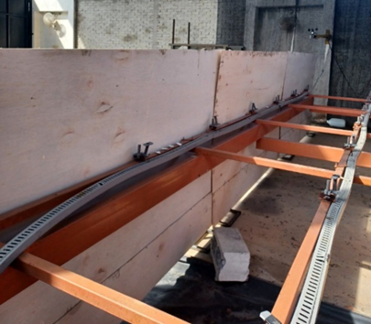
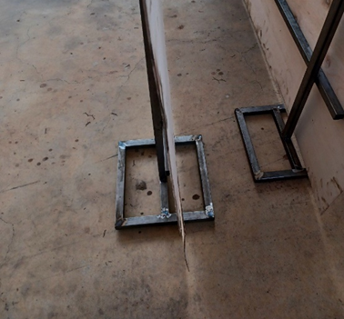
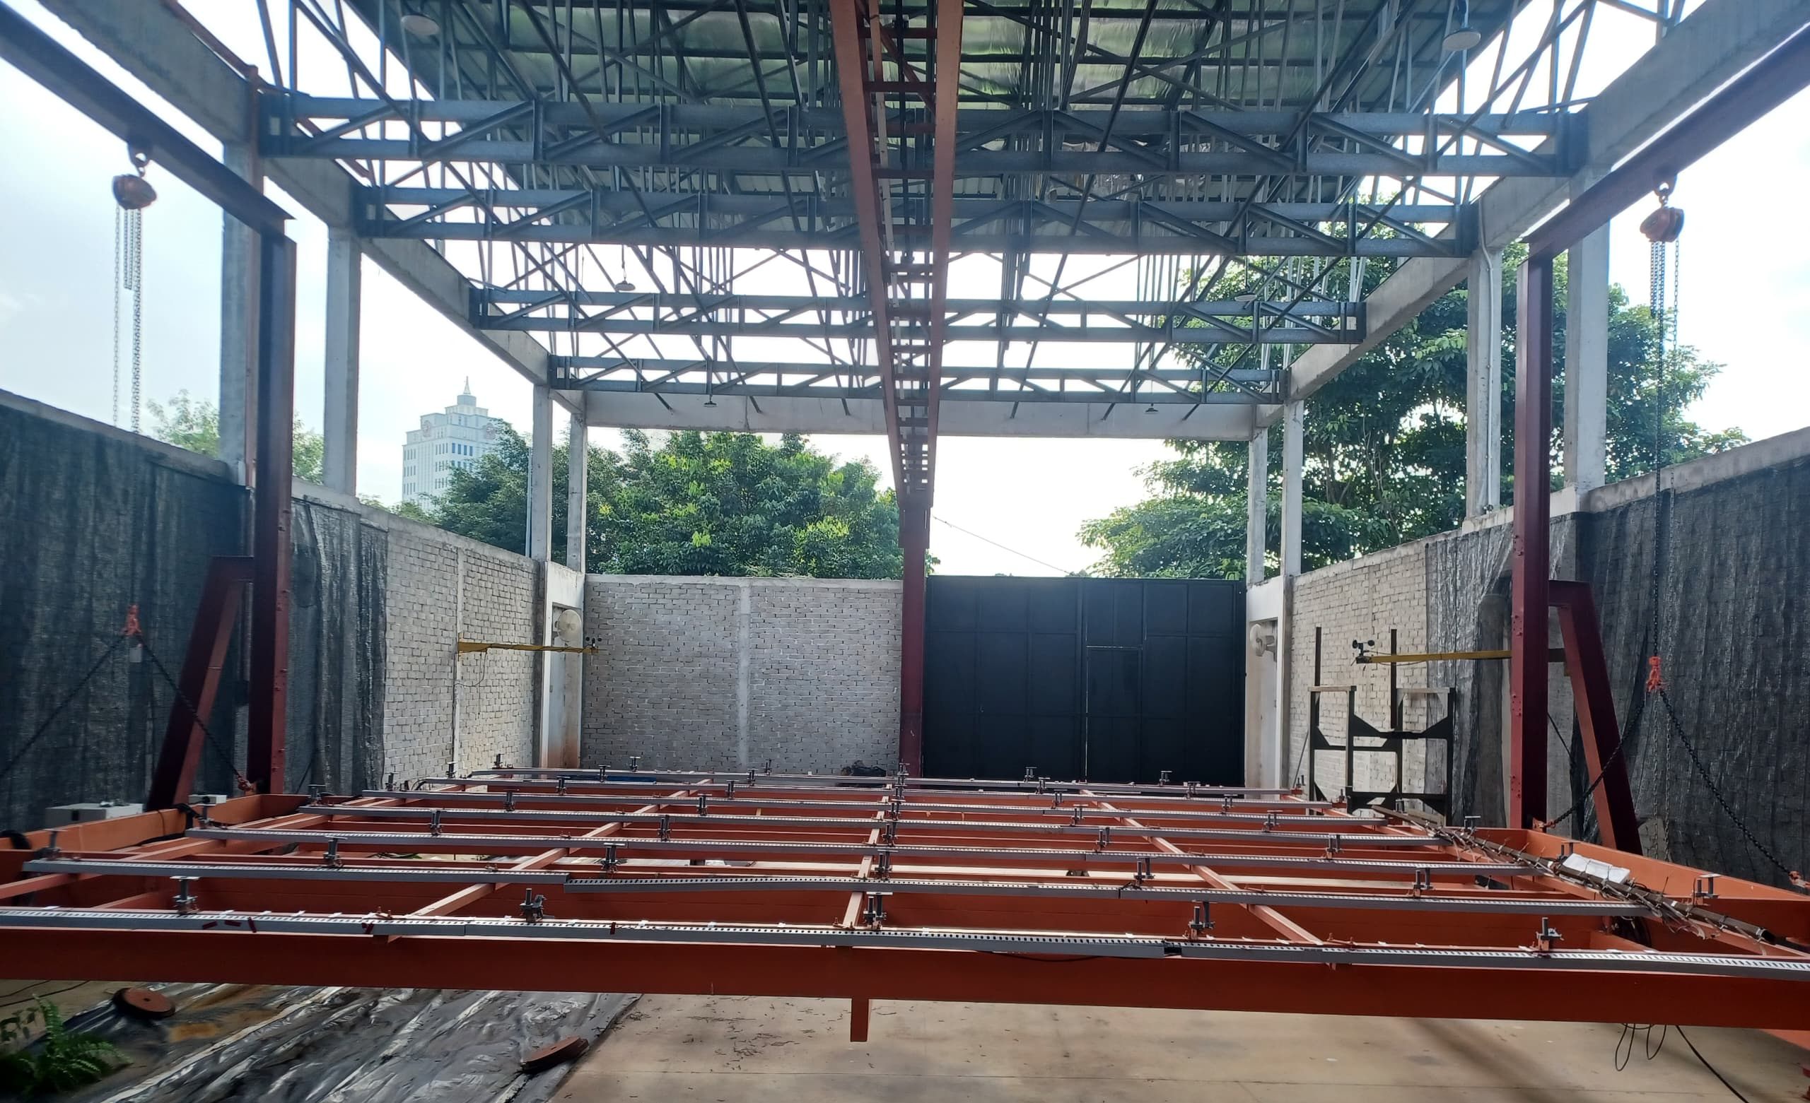
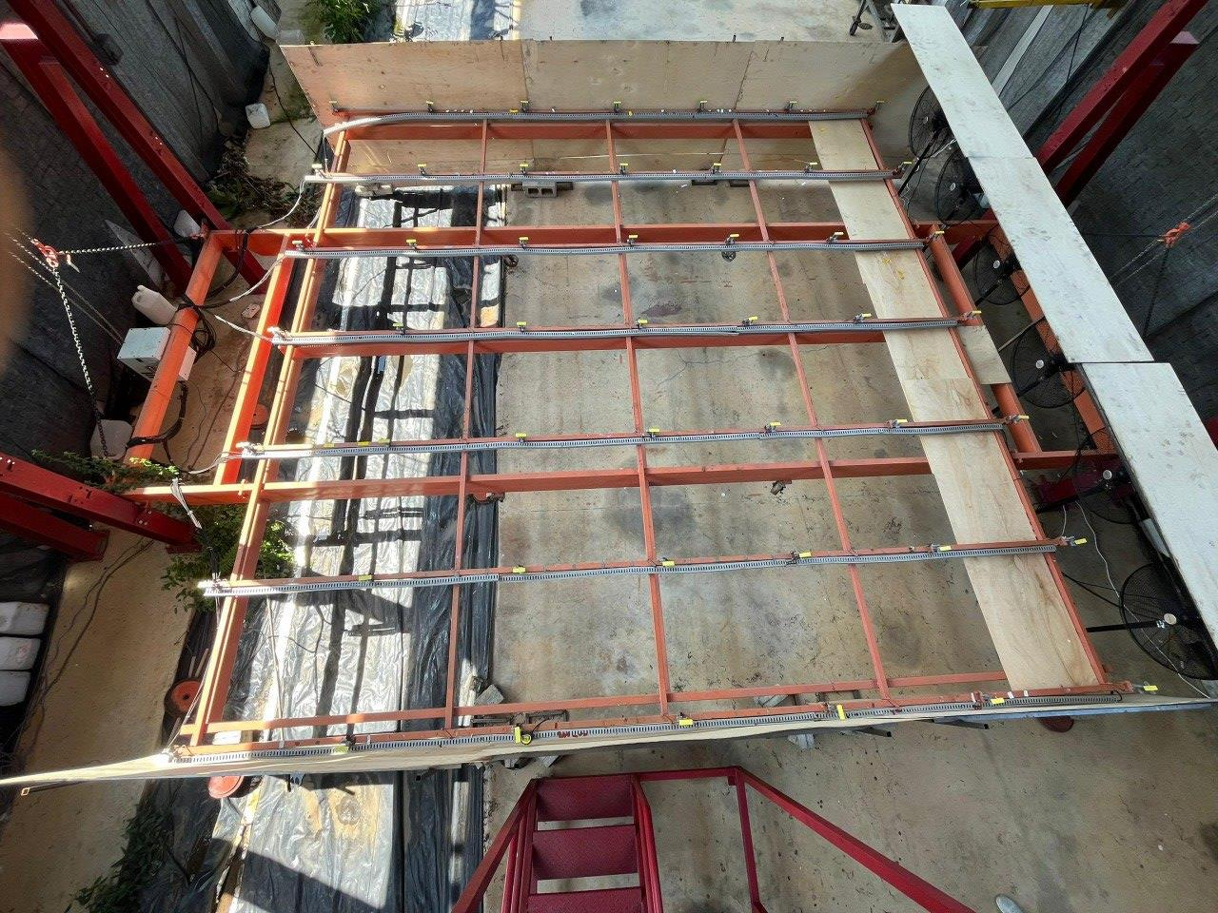
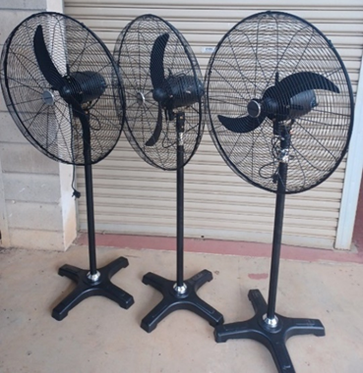
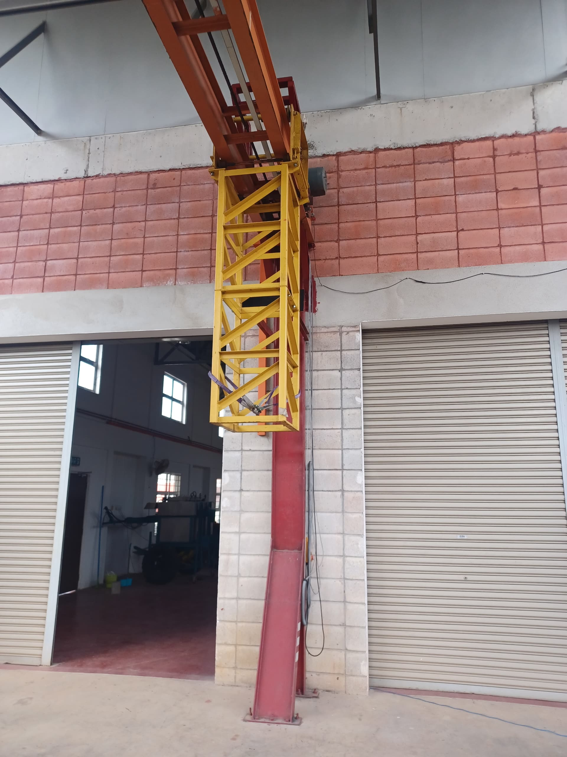
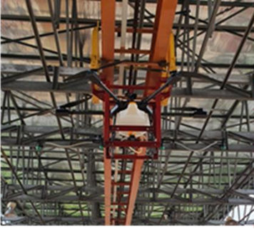
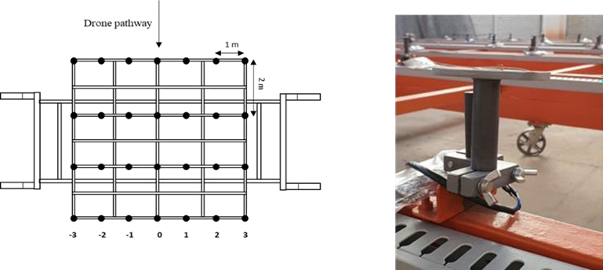
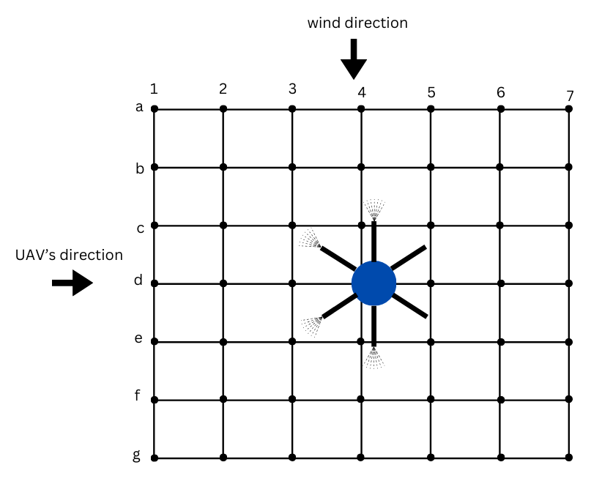
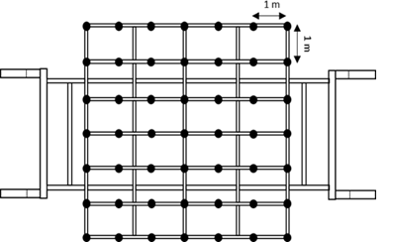
LABORATORY SETUP
BARRIER CONSTRUCTION
Plywood
Stainless steel hollow square 1” x 1”
UAV SPECIFICATION
Hexacopter UAV
Advansia A1
Maximum Payload,16 Liter
METHODOLOGY
ARTIFICIAL WIND
INDOOR UPM LABORATORY
SAMPLING POINT
Sampling point at 1m x 1m grid

Slide 16
BARRIER CONSTRUCTION
Plywood
Stainless steel hollow square 1” x 1”
LABORATORY SETUP
ARTIFICIAL WIND
METHODOLOGY
SAMPLING POINT
Sampling point at 1m x 1m grid
UAV SPECIFICATION
Hexacopter UAV
Advansia A1
Maximum Payload,16 Liter
INDOOR UPM LABORATORY

Slide 17
ARTIFICIAL WIND
SAMPLING POINT
Sampling point at 1m x 1m grid
BARRIER CONSTRUCTION
Plywood
Stainless steel hollow square 1” x 1”
METHODOLOGY
INDOOR UPM LABORATORY
LABORATORY SETUP
UAV SPECIFICATION
Hexacopter UAV
Advansia A1
Maximum Payload,16 Liter

Slide 18
SAMPLING POINT
Sampling point at 1m x 1m grid
INDOOR UPM LABORATORY
ARTIFICIAL WIND
METHODOLOGY
UAV SPECIFICATION
Hexacopter UAV
Advansia A1
Maximum Payload,16 Liter
BARRIER CONSTRUCTION
Plywood
Stainless steel hollow square 1” x 1”
LABORATORY SETUP

Slide 19
INDOOR UPM LABORATORY
UAV SPECIFICATION
Hexacopter UAV
Advansia A1
Maximum Payload,16 Liter
SAMPLING POINT
Sampling point at 1m x 1m grid
METHODOLOGY
LABORATORY SETUP
ARTIFICIAL WIND
BARRIER CONSTRUCTION
Plywood
Stainless steel hollow square 1” x 1”

Slide 20

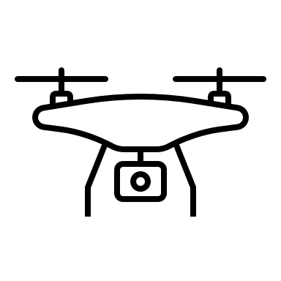
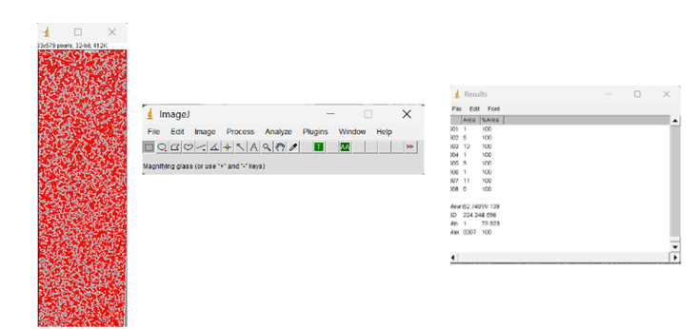
METHODOLOGY
Start
Setup barrier & artificial wind (fans) around the platform
EXPERIMENTAL TEST
Flying height (2.5 m and 3.5 m
Fan speed (2 and 3)
Flying speed (2 m/s and 6 m/s)
DATA COLLECTION
Scanned water sensitive paper
Software
Result from DepositScan
Collect data of wind speed at 49 positions using anemometer
Setup:
UAV at test rig
49 pieces water sensitive papers on platform
Repeat for different fan switch, flying height and flying speed
Run UAV spraying test
Scan water sensitive papers using scanner and analysed using the DepositScan software
End

Slide 21
METHODOLOGY
EXPERIMENTAL TEST
Flying height (2.5 m and 3.5 m
Fan speed (2 and 3)
Flying speed (2 m/s and 6 m/s)
DATA COLLECTION
Scanned water sensitive paper
Software
Result from DepositScan

Slide 22
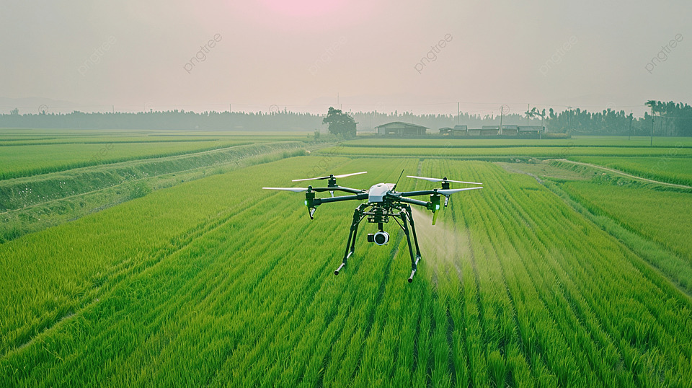
RESULT

Slide 23
RESULT
Distribution pattern of fan’s wind speed at switch 2
Distribution pattern of fan’s wind speed at switch 3

Slide 24
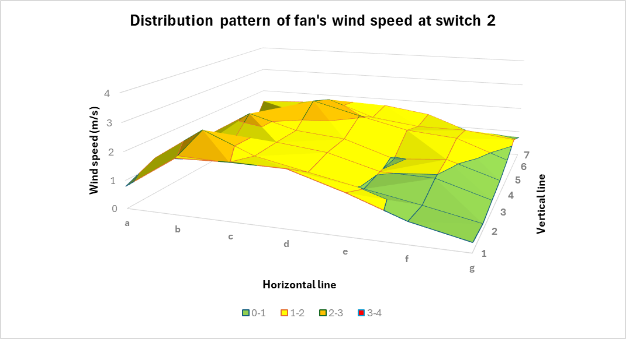
RESULT
Distribution pattern of fan’s wind speed at switch 3
Distribution pattern of fan’s wind speed at switch 2

Slide 25
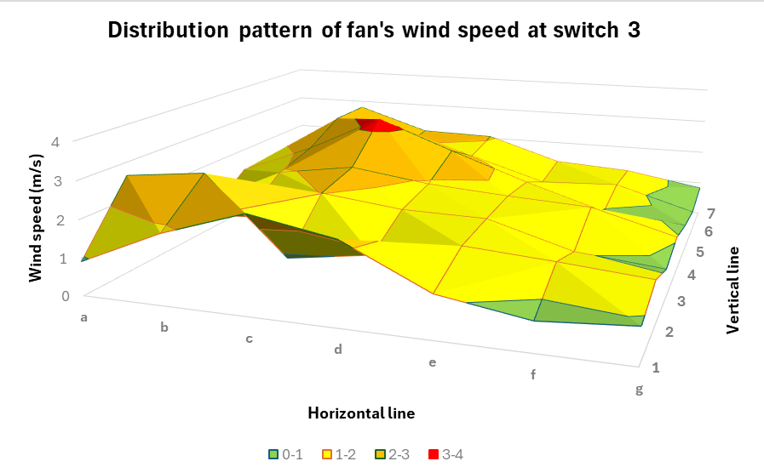
RESULT
Distribution pattern of fan’s wind speed at switch 2
Distribution pattern of fan’s wind speed at switch 3

Slide 26
RESULT
Drift variation due to different flying speed (2.5 m)
Spray distribution pattern
Drift variation due to different flying speed (3.5 m)
Spray distribution pattern

Slide 27
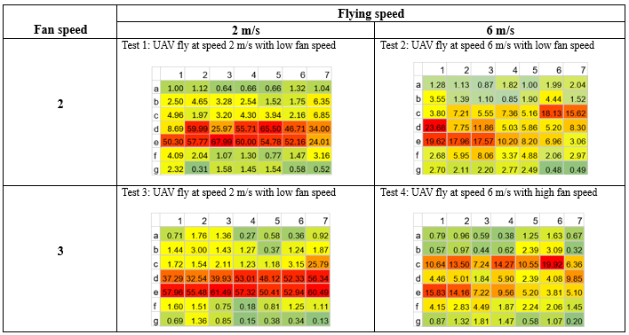
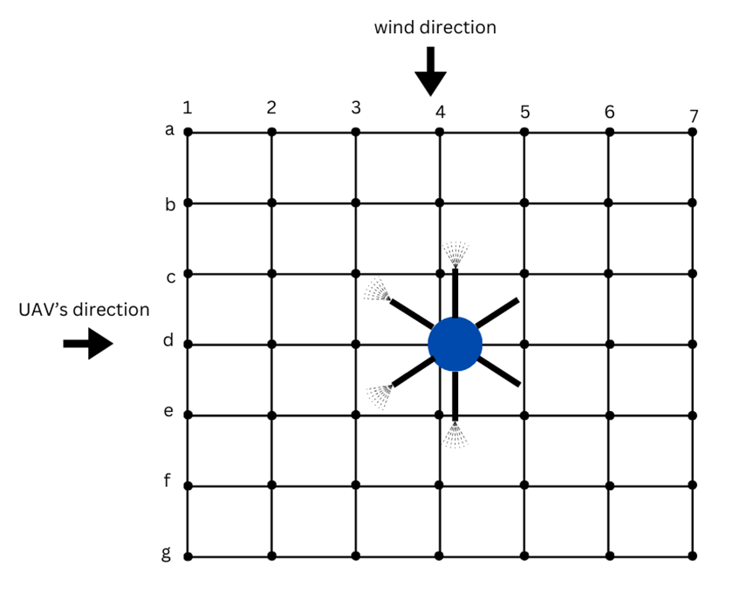
RESULT
Drift variation due to different flying speed (3.5 m)
Spray distribution pattern
Drift variation due to different flying speed (2.5 m)
Spray distribution pattern

Slide 28
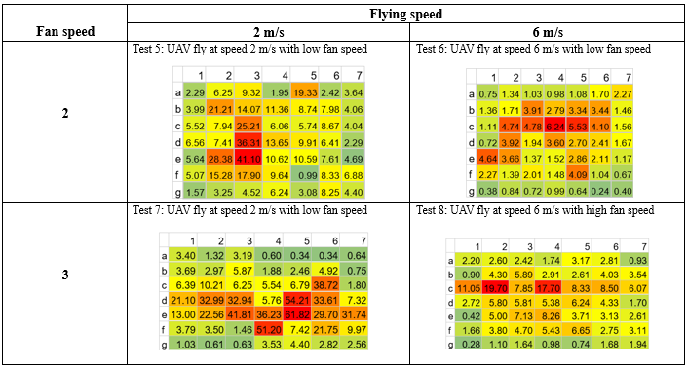
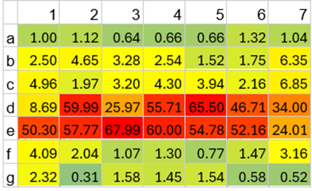
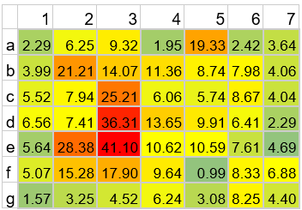
RESULT
Drift variation due to different flying speed (2.5 m)
Spray distribution pattern
Drift variation due to different flying speed (3.5 m)
Spray distribution pattern
The spray distribution pattern is more significant at lower flying height (2.5 m) compared to higher flying height (3.5 m)
(a) UAV fly at speed 2 m/s with low fan speed (2.5 m) (b) UAV fly at speed 2 m/s with low fan speed (3.5m)

Slide 29
The spray distribution pattern is more significant at lower flying height (2.5 m) compared to higher flying height (3.5 m)
(a) UAV fly at speed 2 m/s with low fan speed (2.5 m) (b) UAV fly at speed 2 m/s with low fan speed (3.5m)
RESULT

Slide 30
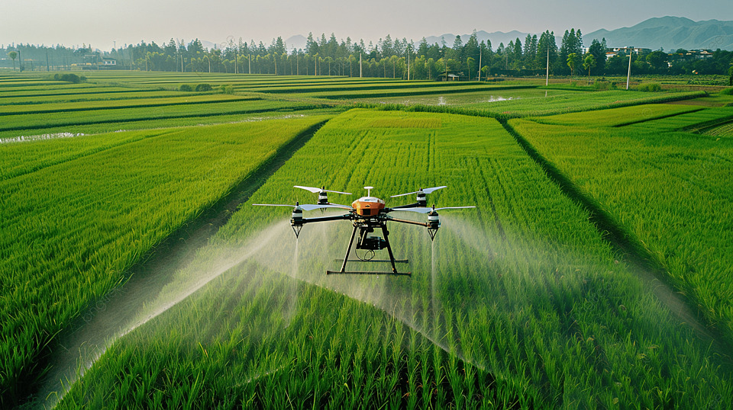
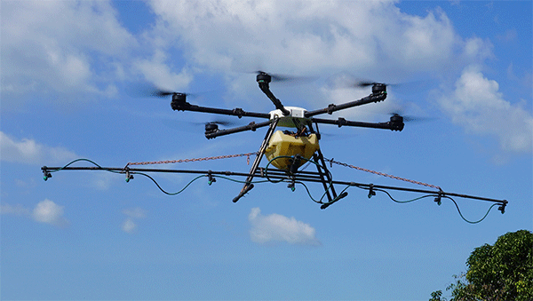


FUTURE WORK
CONCLUSION

Slide 31
CONCLUSION
Optimizing Sprayer Configurations
Transitioning from the extended Y-type sprayer to a boom sprayer setup to evaluate its effects on spray drift characteristics and efficiency.

Slide 32
CONCLUSION
Field Testing
Conducting field trials to validate the findings under realistic environmental and operational conditions, providing critical insights into the practical performance of the UAV sprayer.

Slide 33
CONCLUSION
Prediction Model Integration
Utilizing the developed spray drift prediction model to compare simulated outcomes with actual field observations, enabling further refinement and validation of the model for operational use.

Slide 34



Implications for Agricultural Practices
CONCLUSION

Slide 35
CONCLUSION
Enhanced Application Efficiency
Precise prediction and control of spray drift allow for better targeting of agrochemicals, ensuring they are deposited on the intended area. This reduces waste and maximizes the effectiveness of pesticides, herbicides, and fertilizers.

Slide 36
CONCLUSION
Minimized Environmental Impact
By reducing off-target drift, the research helps mitigate contamination of nearby ecosystems, including water bodies, non-target crops, and natural habitats, thereby promoting more sustainable agricultural practices.

Slide 37
CONCLUSION
Improved Health and Safety
Decreased drift lowers the exposure risk for farmworkers, local communities, and wildlife to potentially harmful chemicals, aligning with public health and environmental safety standards.

Slide 38
CONCLUSION
Economic Benefits
Farmers benefit from reduced costs due to lower agrochemical waste and decreased liability for unintended crop damage or environmental harm. Accurate prediction and mitigation also enhance compliance with regulatory frameworks, avoiding potential fines.

Slide 39

THANK YOU

