Slide 1


TITLE: THE IMPACT OF FOUR COMPONENT INSTRUCTIONAL DESIGN ONCURRICULUM IMPROVEMENT OF DANCE IN HEBEI VOCATIONAL ARTS COLLEGE, CHINA
1 Jin Xuan, 2 Sharip Zainal Bin Sagkif Shek, 3 Low Kok On, 4 Sri Ningsih Sukirman
1 Hebei Vocational Arts College, China
2,3,4 The Academy of Arts & Creative Technology, Universiti Malaysia Sabah
Date: 12 September 2024

Slide 2
CONTENTS
01
INTRODUCTION
02
METHODOLOGY
03
RESULTS
04
CONCLUSIONS

Slide 3
1. INTRODUCTION
Exploring the Positive Impact of Jeroen van Merriënboer's 1997 Four-Component Instructional Design (4C/ID) Model on the Improvement of the Dance Performance Curriculum at Hebei Vocational College of the Arts.
To address the problem of fragmented and inconsistent curriculum content and lack of systematic instructional design due to the reliance on teacher experience in dance programmes.
Employing a case study approach, the study focuses on the Collective Dance Performance(CDP) course, aiming to align the curriculum with real-world job competencies and enhance teaching effectiveness in vocational dance education in China.

Slide 4
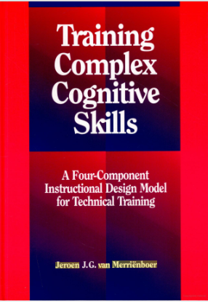

1. INTRODUCTION
In vocational education, designing and implementing effective instructional programs has always been a critical area of research. The Four Component Instructional Design model, or 4C/ID, introduced by Jeroen van Merriënboer in 1997, has been widely applied across vocational and higher education.
Van Merriënboer, J. J. (1997). Training complex cognitive skills: A four-component instructional design model for technical training.
Van Merriënboer, J. J., & Kirschner, P. A. (2017). Ten steps to complex learning: A systematic approach to four-component instructional design
Its application in arts education, particularly dance, remains largely unexplored. Our study aims to bridge this gap by examining how this model can be applied to the dance performance curriculum.

Slide 5
2. METHODOLOGY
Case study aimed at engaging with and reporting the educational activities that it can take an example of an activity — 'an instance in action' — and use multiple methods and data sources to explore it and interrogate it (Somekh & Lewin, 2005: 53 ).
Case
Study
When the focus of the study is to answer “how ” and “why ” questions, you should use a case study approach (Yin, 2003: 24) .
To explore the complex dynamics of instructional design in dance performance curriculum contributes to a comprehensive understanding of the processes and outcomes associated with educational interventions in this field.

Slide 6

2.1 Principles on 4C/ID
The Four Component Instructional Design model is considered one of the most competitive instructional design theories of our time, and is particularly relevant in improving instructional efficacy, focusing on complex learning, and enabling learning transfer (Sheng & Ma, 2018, Francom, 2018, Güney, 2019, Costa, Miranda & Melo, 2022).
Learning task
Derived from real work tasks
Supportive
information
The background information that serves the learner to solve problems creatively
Procedural
information
Information on standardised processes for
service learners to access knowledge
Jeroen J.G. van Merrinboer
（1959-）
There is clear, repeatable information about the skills that can be mastered with training
Part-task
practice

Slide 7

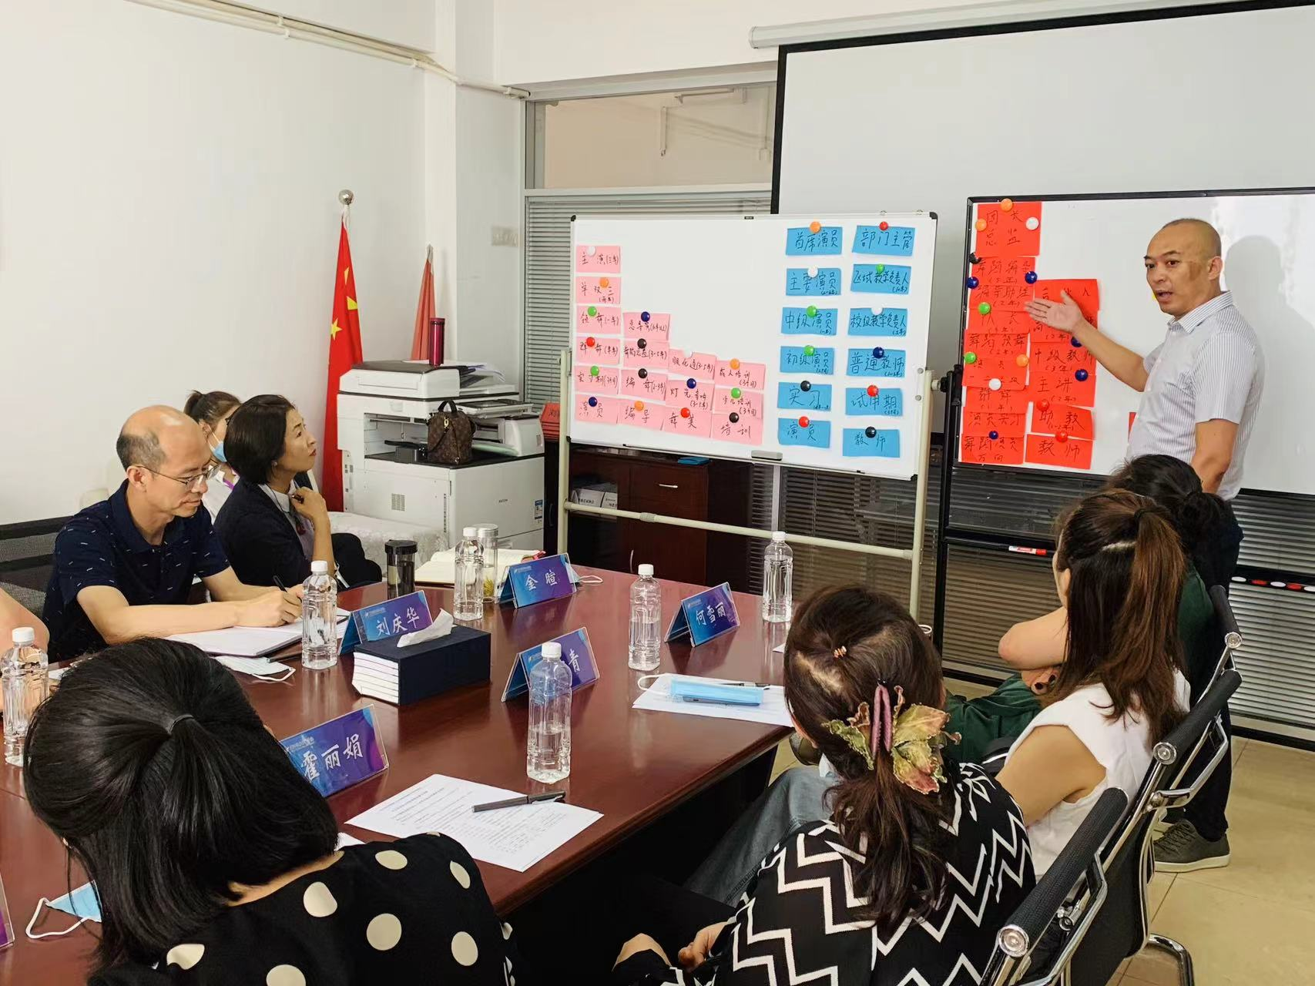
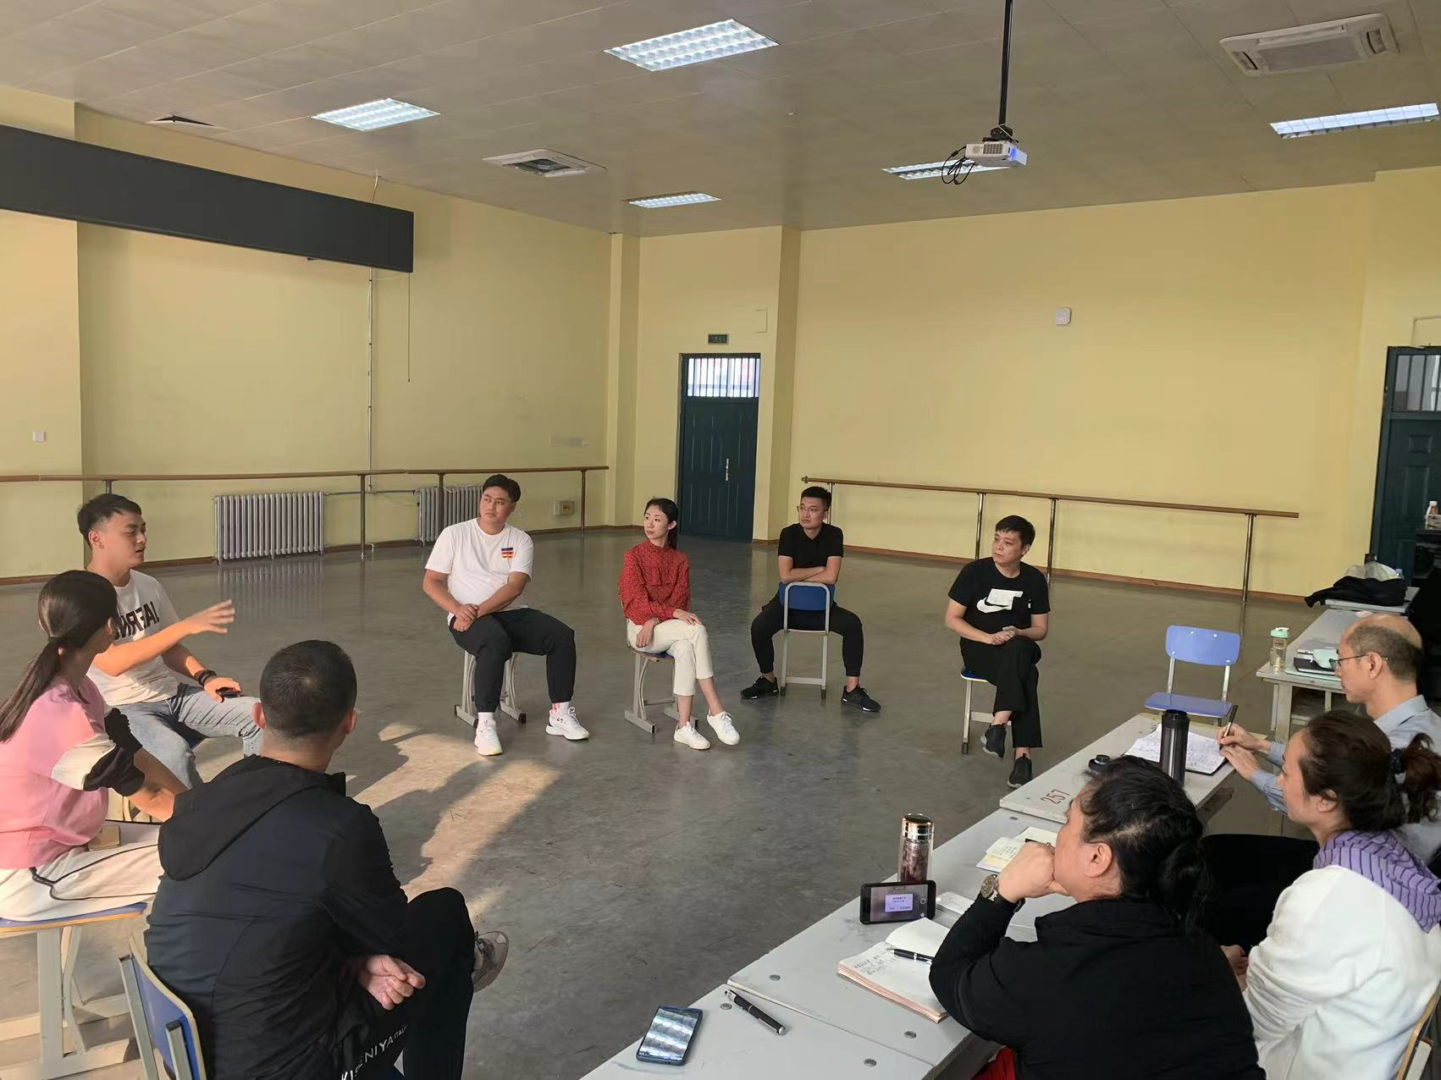
2.2 Data Collections
The data collection methods used were qualitative in nature and included in-depth interviews, focus group discussions with dancers, dance instructors, and graduates of the dance performance major, and observations of the curriculum implementation process.
Data collection methods
In-depth
interviews
Focus group discussions
Observations
of the class
In HVAC conference room
In dance training hall

Slide 8
2.2 Data Collections
Duration of field work
May 27 to October 10, 2020
Actively participated in the validation process and overall construction of the CDP course in the observation dance program.
Data collection
Participant observation
Interviewees: dance practice experts and industry professionals
In-depth interview
Bi-weekly data collection
Discussed new experiences in teaching and learning with the course team, students and graduates.
Focus group interview

Slide 9
2.3 DATA ANALYSIS
The data analysis is structured around the seven phases of course design outlined by the Four-Component Instructional Design (4C/ID) model (Yang & Liu, 2022: 5).
IV
III
V
Determine constituent skills
Design learning tasks
Extract and organize learning conten
II
VI
Select instructional strategies
Desigh learning task categories
I
VII
Identify
real-wprld
tasks
Design instructional implementaion plans
7 Stages of curriculum design

Slide 10
2.3 DATA ANALYSIS
Table 1. Data Analysis Framework
Course Development Steps | Data Analysis Conditions | Key Points of Data Collection
Identify Real-World Tasks | Clarify which real-world tasks the course corresponds to. Describe the application scenarios students will encounter after graduation. Understand the competency boundaries of real-world tasks. | Typical tasks in the dancer’s work. Developmental characteristics of tasks in the dancer’s profession.
Design Learning Task Categories | Rank real-world tasks based on their complexity, explain the reasons for the ranking, and categorize the tasks by difficulty level. | Detailed process by which dancers complete performance tasks.
... | ... | ...

Slide 11
2.3 DATA ANALYSIS
Alignment with Industry Tasks
Structured Skill Development
The application of the 4C/ID model ensured the CDP course content closely mirrors the real-world tasks and professional competencies required in the dance industry.
Dance skills were systematically broken down and organized into targeted learning objectives, creating a clear pathway for student skill acquisition.
Validated Teaching Strategies
Enhanced Student Preparedness
Instructional plans, refined and validated through interviews and focus groups, effectively support the development of essential dance competencies.
The resulting curriculum not only meets industry standards but also significantly improves the professional readiness of CDP course students.

Slide 12
3 RESULTS
Combining Artistic Creativity with Instructional Structure:
By integrating the intuitive and creative aspects of dance with a structured educational framework, the 4C/ID model offers a systematic approach that enhances curriculum coherence. This method facilitates the perfect fusion of traditional practice-based dance education with modern instructional design theories.

Slide 13
3 RESULTS
Enhancing the Logic of Dance Teaching and Systematic Curriculum Design
The 4C/ID model addresses the fragmentation inherent in traditional dance education by integrating various skills and knowledge required for group dance performances. This ensures that learners are appropriately challenged and remain within their zone of proximal development, thereby maintaining consistent quality and effectiveness in instruction.

Slide 14
3 RESULTS
Pioneering and Impactful Application:
This marks the first application of the 4C/ID model in the development of a dance curriculum, making it a pioneering effort. The model demonstrates significant potential to transform traditional arts education and serves as a reference for future curriculum development in the arts.

Slide 15
4 CONCLUSIONS
In conclusion, the 4C/ID model has proven effective in systematically enhancing the instructional design of dance courses at Hebei Vocational Arts College (HVAC).
We wish to reflect on the dance curriculum as an educational act from the perspective of the participants rather than exploring directions and goals for programme improvement from a purely artistic perspective.

Slide 16
Thank you!

